Slide 1

NEWBIES

Slide 2
01
02
03
04
05
06
The Team
About Idea
Use Cases Covered
Architecture Overview
Your Idea & Digital Disruption
Future Path

Slide 3
The Team

Slide 4
Team, Members and their Role
Developers
Abhishek Madan - CTO
Bhushan Raut
Pravin Mulchandani
Ashwini Deotare
Testers
Ashwini Ambadare
Pratik Lad
Notes:
TITLE AND TEXT
– Headline 32pt Arial in BLACK
– Body copy & bulleted text 12pt Arial Reg in GRAY; body copy not to go below 10 pt
– Left-justify all text and design element

Slide 5
About Idea

Slide 6
About Idea
Simulate smart kitchen kit that keeps track of quantity of various items(Liquid,Solid) in Kitchen.
Android Mobile App
Tracking the quantity of groceries in Kitchen
For Liquid Volume detection = Proximity sensor and Level Detector , in the “SMART CONTAINER “.
For Solid = Pressure Sensor
It provide list-making capabilities
Provides notifications when your items quantity goes low.
Also Provides the last used/ refilled information of the commodity in the “SMART CONTAINER”.
Notes:
TITLE AND TEXT
– Headline 32pt Arial in BLACK
– Body copy & bulleted text 12pt Arial Reg in GRAY; body copy not to go below 10 pt
– Left-justify all text and design element

Slide 7
Use Cases Covered

Slide 8

Use Cases Covered
Keeps Track of quantity
Gives Notification
Provide quick shopping
Provide Local Shop for shopping
Maintains Hygiene
Notes:
TITLE AND TEXT
– Headline 32pt Arial in BLACK
– Body copy & bulleted text 12pt Arial Reg in GRAY; body copy not to go below 10 pt
– Left-justify all text and design element

Slide 9
Architecture Overview

Slide 10

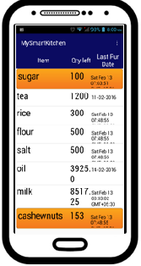
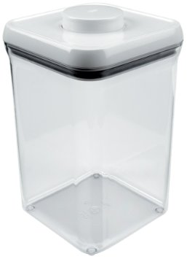
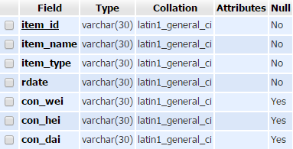
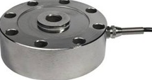
Architecture Overview
Proximity sensor (to measure diameter)
Array of IR sensors (to detect level of volume)
Web server
Pressure sensor
Smart Container
Mobile Application
Notes:
TITLE AND TEXT
– Headline 32pt Arial in BLACK
– Body copy & bulleted text 12pt Arial Reg in GRAY; body copy not to go below 10 pt
– Left-justify all text and design element

Slide 11
Snapshots

Slide 12
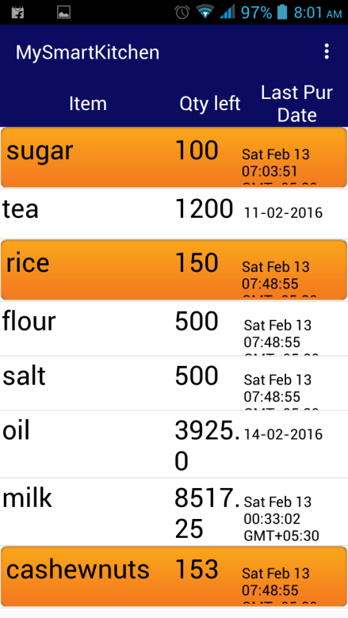
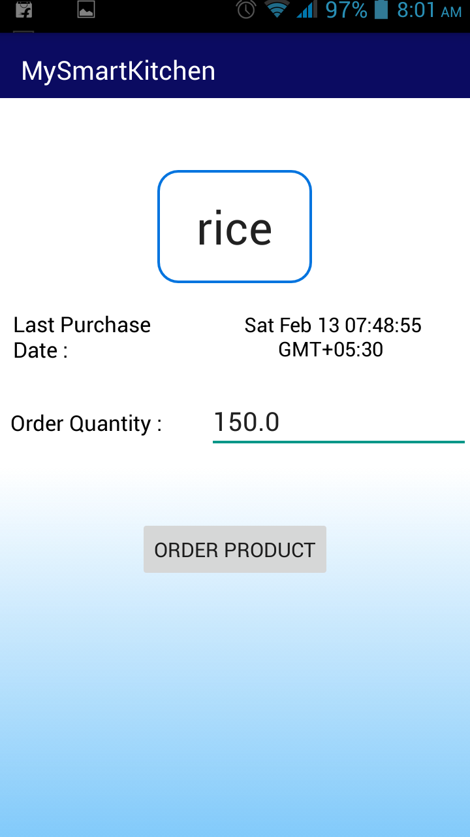
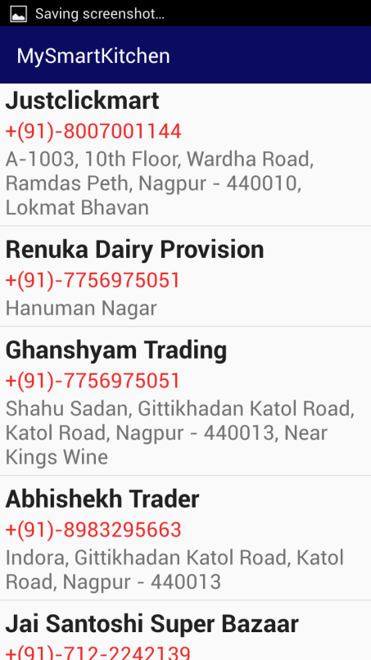
Snapshots
Notes:
TITLE AND TEXT
– Headline 32pt Arial in BLACK
– Body copy & bulleted text 12pt Arial Reg in GRAY; body copy not to go below 10 pt
– Left-justify all text and design element

Slide 13
Your Idea & Digital Disruption

Slide 14
Your Idea & Digital Disruption
Idea of “My Smart kitchen” helps you to maintain grocery items at your home using your smart phones
This will increase the business value for the local grocery stores using digital disruption
Notes:
TITLE AND TEXT
– Headline 32pt Arial in BLACK
– Body copy & bulleted text 12pt Arial Reg in GRAY; body copy not to go below 10 pt
– Left-justify all text and design element

Slide 15
Future Path

Slide 16
Future Path
Connect people with nearby Glossary store
Business Profit
Scope for future investment
Notes:
TITLE AND TEXT
– Headline 32pt Arial in BLACK
– Body copy & bulleted text 12pt Arial Reg in GRAY; body copy not to go below 10 pt
– Left-justify all text and design element

Slide 17
Thank you

